Slide 1
Liabilities - Accounting Principles
2022. 5.
Yangin Yoon

Slide 2
Agenda
Recap the last class
Bond (Liability)
- Simplified
- Using Contra Account
Bonds Retirements before Maturity
Contingent Liability

Slide 3

Recap the last class (Financial Assets)
For example, the company gets $500 annually for three years, and $10,000 (principle) three years later.
- The current annual interest rate is 6%. What is the fair value of this cash flow?
→ Present value = $\frac{500}{{(1+0.06)}^{1}}$ + $\frac{500}{{(1+0.06)}^{2}}$ + $\frac{500}{{(1+0.06)}^{3}}$ + $\frac{10,000}{{(1+0.06)}^{3}}$= 9,733
 | 2022.1.1. | 2022.12. | 2023.12 | 2024.12 | Sum of three years
Nominal amount | 0 | 500 | 500 | 10,500 | 11,500
Interest rate | 0.06
Discount factor | 1 | 0.943 | 0.890 | 0.840
Present Value | 0 | 472 | 445 | 8,816 | 9,733

Slide 4
Recap the last class (Financial Assets)
2022.1.1.
2022.12.31.
9,733*0.06 = 584
2023.12.31.
9,817*0.06 = 589
 | Interest Income | Value before the interest payment (A) | Small payback (B) | Value after payment (C=A-B)
2022.1.1. | - | 9,733 |  | 9,733
2022.12.31. | 584 (=9,773 * 6%) | 10,317 (=9733*1.06) | 500 | 9,817
2023.12.31. | 589 (=9,817 * 6%) | 10,406 (=9817*1.06) | 500 | 9,906
2024.12.31. | 594 (=9,906 * 6%) | 10,500 (=9906*1.06) | 500 | 10,000
Financial Assets 9,733
Cash 9,733
Financial Assets 84
Cash 500
Interest income 584
Financial Assets 89
Cash 500
Interest income 589

Slide 5
Any Questions?

Slide 6

Bond (Liability)
One of the sources that a company borrow fund is bond.
Bond has three elements.
- Face value (principal amount)
- Coupon rate
- Maturity
The initial price is calculated by calculating the present value of future cash flow.
- When we calculate an NPV, we use an effective interest rate (market interest rate).

Slide 7
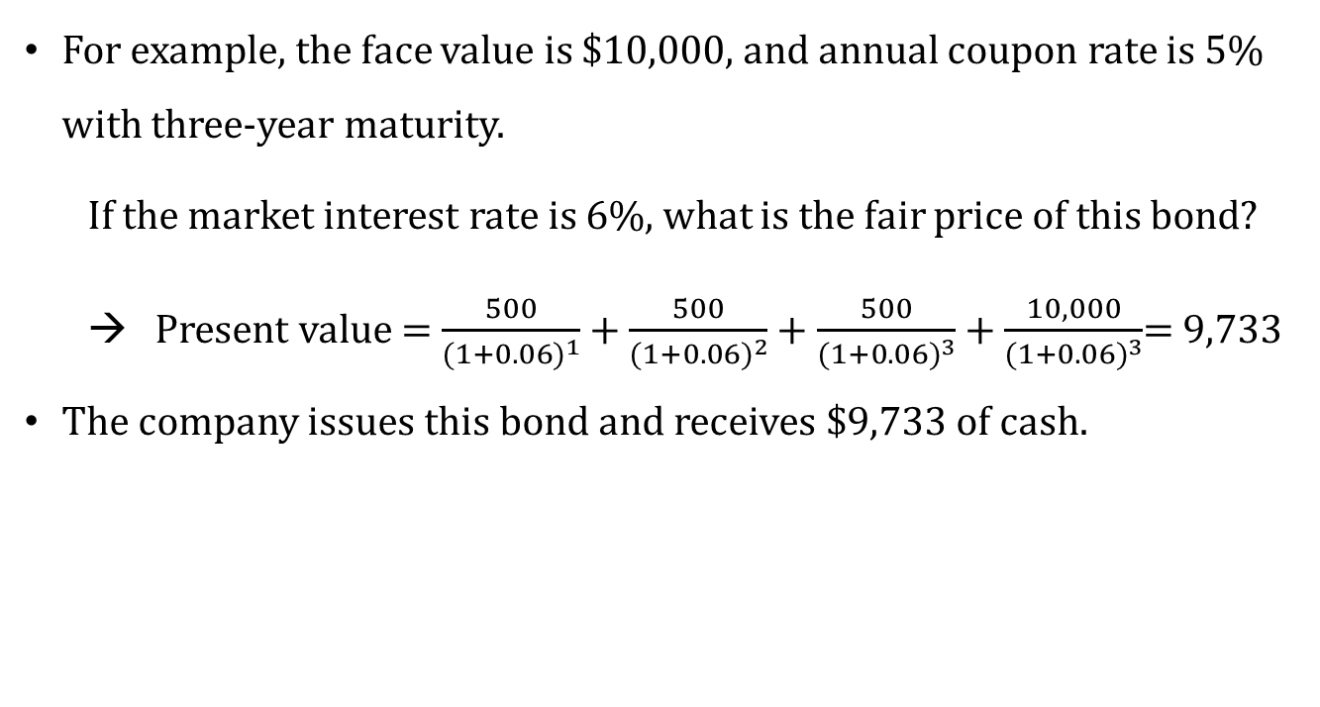
Bond (Liability)
For example, the face value is $10,000, and annual coupon rate is 5% with three-year maturity.
If the market interest rate is 6%, what is the fair price of this bond?
→ Present value = $\frac{500}{{(1+0.06)}^{1}}$ + $\frac{500}{{(1+0.06)}^{2}}$ + $\frac{500}{{(1+0.06)}^{3}}$ + $\frac{10,000}{{(1+0.06)}^{3}}$= 9,733
The company issues this bond and receives $9,733 of cash.
 | 2022.1.1. | 2022.12. | 2023.12 | 2024.12 | Sum of three years
Nominal amount | 0 | 500 | 500 | 10,500 | 11,500
Interest rate | 0.06
Discount factor | 1 | 0.943 | 0.890 | 0.840
Present Value | 0 | 472 | 445 | 8,816 | 9,733

Slide 8
Bond (Liability)
There are three main events:
1) Bond issuance
2) Interest payments
3) Principal payments
Cash YYY
Discount on Bonds Payable XXX- YYY
Bonds Payable XXX
Bond Interest Expense AAA
Cash BBB
Discount on Bonds Payable AAA - BBB
Bonds Payable XXX
Cash XXX

Slide 9
Bond (Liability) - Simplified
 | Effective Interest | Bond Value before Interest Payment | Coupon Amount | Bond Value after Payment
2022.1.1. | - | 9,733 |  | 9,733
2022.12.31. | 584 (=9,773 * 6%) | 10,317 (=9733*1.06) | 500 | 9,817
2023.12.31. | 589 (=9,817 * 6%) | 10,406 (=9817*1.06) | 500 | 9,906
2024.12.31. | 594 (=9,906 * 6%) | 10,500 (=9906*1.06) | 500 | 10,000
2022.1.1.
Cash 9,733
Bonds Payable 9,733
2022.12.31.
Bond Interest Expense 584
Cash 500
Bonds Payable 84
2022.12.31.
Bond Interest Expense 589
Cash 500
Bonds Payable 89
2022.12.31.
Bond Interest Expense 594
Bonds Payable 10,000
Cash 500
Bonds Payable 94
Cash 10,000

Slide 10
Bond (Liability) – Using Contra account
 | Effective Interest | Bond Value before Interest Payment | Coupon Amount | Bond Value after Payment
2022.1.1. | - | 9,733 |  | 9,733
2022.12.31. | 584 (=9,773 * 6%) | 10,317 (=9733*1.06) | 500 | 9,817
2023.12.31. | 589 (=9,817 * 6%) | 10,406 (=9817*1.06) | 500 | 9,906
2024.12.31. | 594 (=9,906 * 6%) | 10,500 (=9906*1.06) | 500 | 10,000
2022.1.1.
Cash 9,733
Discount on Bonds Payable 267
Bonds Payable 10,000
* “Discount on Bonds Payable” is a liability type account.
2022.12.31.
Bond Interest Expense 584
Cash 500
Discount on Bonds Payable 84
2022.12.31.
Bond Interest Expense 589
Cash 500
Discount on Bonds Payable 89
2022.12.31.
Bond Interest Expense 594
Bonds Payable 10,000
Cash 500
Discount on Bonds Payable 94
Cash 10,000
https://dart.fss.or.kr/dsaf001/main.do?rcpNo=20220317000816&dcmNo=8471591

Slide 11
Any Questions?

Slide 12
Bonds Retirements before Maturity
The ABC company pays $500 annually for three years, and $10,000 (principle) after three years.
- The current market interest rate is 6%
On 2023.12.31., after paying $500, the ABC company gets the bond by paying $9,950 from the bond market.
 | Effective Interest | Bond Value before Interest Payment | Coupon Amount | Bond Value after Payment
2022.1.1. | - | 9,733 |  | 9,733
2022.12.31. | 584 (=9,773 * 6%) | 10,317 (=9733*1.06) | 500 | 9,817
2023.12.31. | 589 (=9,817 * 6%) | 10,406 (=9817*1.06) | 500 | 9,906
2024.12.31. | 594 (=9,906 * 6%) | 10,500 (=9906*1.06) | 500 | 10,000
2022.12.31.
Bonds Payable 9,906
Loss on Bond Retirement 44
Cash 9,950
Or
2022.12.31.
Bonds Payable 10,000
Loss on Bond Retirement 44
Cash 9,950
Discount on Bonds Payable 94
* “Loss on Bond Retirement” is an expense type account (= “Losses on bond redemption”).

Slide 13
Contingent Liability
A potential liability that depends on the future outcome of past events.
- Possible obligation to be confirmed by a future event
- Present obligation that may/may not require outflow of resources
- Reliable estimate of amount of present obligation cannot be made
Examples: future liabilities that may arise due to lawsuits, tax disputes, or alleged violations of environmental protection laws.
https://dart.fss.or.kr/dsaf001/main.do?rcpNo=20220317000816&dcmNo=8471591

Slide 14
Any Questions?

Slide 15
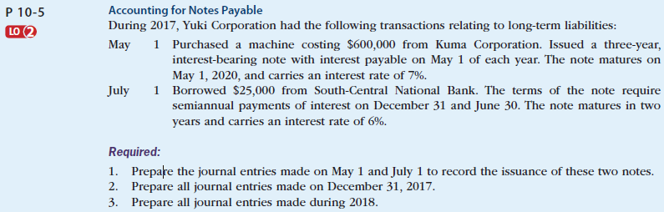
Liability (exercise)
Self-Study Material
© 2017 Cengage Learning, Principles of Financial Accounting, 2/E (IFRS Edition)

Slide 16
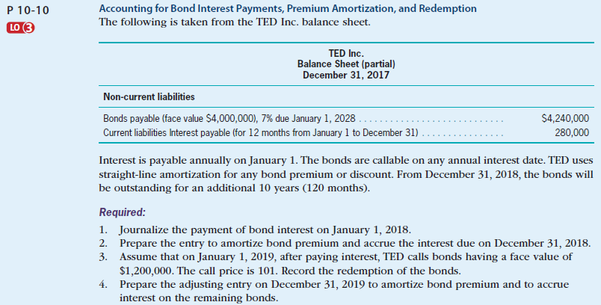
Liability (exercise)
Self-Study Material
© 2017 Cengage Learning, Principles of Financial Accounting, 2/E (IFRS Edition)

Slide 17
Any Questions?

